Slide 1
Youth Area & Skate Park at Abbey Quarter
November 2017

Slide 2
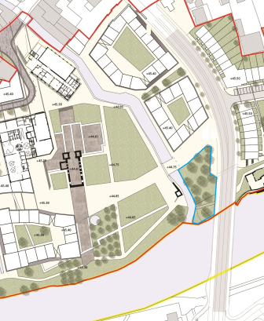
Background
Abbey Creative Quarter Masterplan
Section 4.3.3 Linear Park Strategy
“...the design of the park will also provide for a skate park facility within the masterplan area..”
Part VIII Riverside Garden Project
Identified area between River Breagagh & St Francis Bridge as location for proposed skate park
Consultation
Kilkenny Recreation & Sports Partnership
Sport Ireland – Dormant Accounts Fund
Callan Workhouse Union

Slide 3
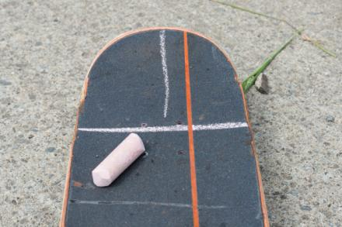
Introduction
Key Objectives for Youth Space
Inclusive
Open to all young people
Meet the needs of local Kilkenny skaters
Process
Design led workshops with wider youth community
Meeting with key skate park advocates and understanding recent community led initiatives for skate park.
On site Co Design Workshop with Spanish Architects Todo por la Praxis and young skaters
Steering Group
Kilkenny Recreation & Sports Partnership
Kilkenny County Council
Callan Workhouse Union
Kilkenny Childcare Committee

Slide 4
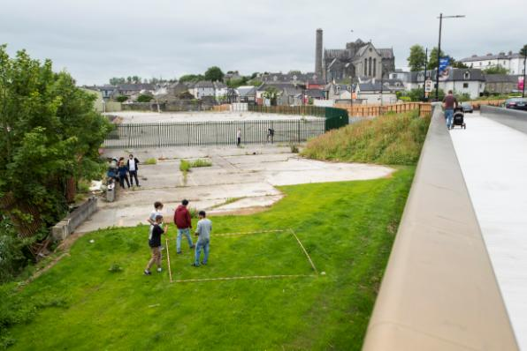
Location
Proposed Site location
Confluence of River Breagagh / River Nore
Adjacent to St Francis Bridge
Feedback from consultation
Location is a huge asset
Suits climate – shelter
Centrally located
Ease of access when Riverside Garden
is developed.
Strong precedent internationally

Slide 5
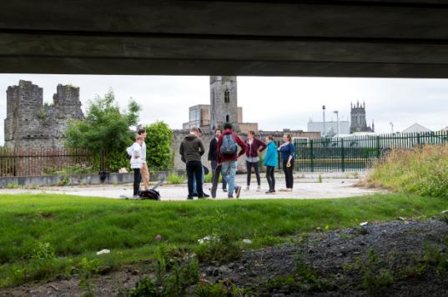
Public Engagement
Public Engagement
Foroige Group
Urban Sports Kilkenny / Paradicals
Colaiste Pobail Osrai x 2
Kilkenny City Vocational School x 2
Presentation Secondary School
Young Irish Film Makers
Comhairle na nOg
Paradicals
Ciclovia
11 workshops
Over 200 young people

Slide 6
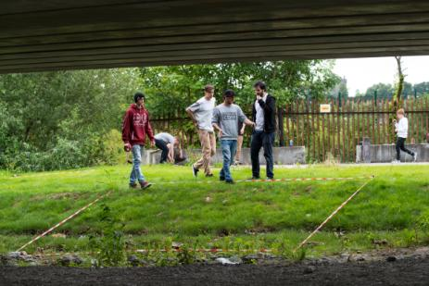
Kilkenny City : Public Space
Kilkenny City : Public Space
A sense of place & belonging
Workshops focused on young peoples relationship with public space in the city centre
Perception of safety & belonging
Five Themes
My Familiar Space
My Social Space
My Open Space
My City Space
Shifting our sense of Place

Slide 7
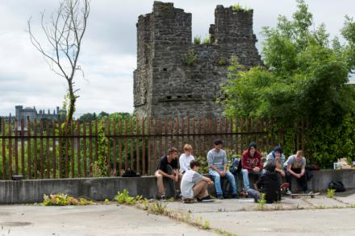
Kilkenny City : Public Space
Familiar Space : Home
Strong identification with home and environs
Familiarity
My social space : School, Youth groups, Sports
Secondary school
Ossory Youths desart Hall
Barnstorm
Young Irish film Makers
Foroige
Watershed
The Drum
Sports Clubs

Slide 8
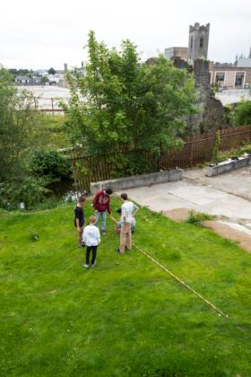
Kilkenny City : Public Space
My Open Space : Parks & Rivers
Castle Park
Young people over 12 not allowed to use playground
Lack of any facility in the park for older children
Feel safe in the grassed areas
Rivers
Conflicting experience
Lifeguard supervision
Life buoys
Safety of personal belongings on river bank

Slide 9
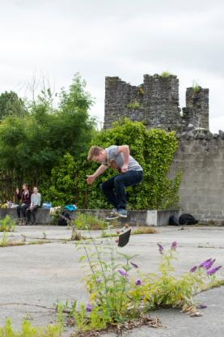
Kilkenny City Public Space
My City Space : Streets, Lanes & Footpaths
Do you hang out alone in small or large groups ?
Is the cityscape a play space for you – skating, blades, running ?
What are your attitudes to drinking smoking and drugs ?
Sense of anxiety entering some city spaces – intimidated by older
teenagers or adults
Unsafe areas included areas that were not being maintained.
Lack of public lighting cited as an issue in relation to a sense of safety.
Young people outlined a perception of Kieran street being unsafe
due to behaviour of some older teenagers.
Often asked to leave fast food outlets.
Skateboarders regularly asked to move on.

Slide 10
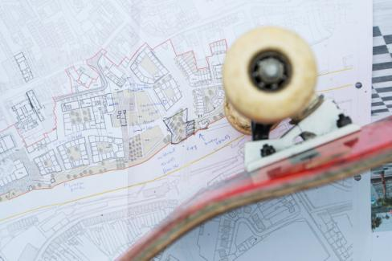
Kilkenny City Public Space
My City Space : Streets, Lanes & Footpaths
Positive features for safe and enjoyable public spaces
Easy accessibility,
Proximity
Good Seating
Good Lighting
Tables
WiFi
Shelter
Grass
Lots of space
Accessible late into the evening

Slide 11
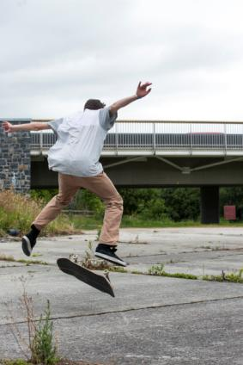
Kilkenny City Public Space
Shifting our sense of place
Groups of Young People congregating in public space,
without proper facilities, is perceived as ‘anti social
behaviour’
Young people feel excluded from public, social and
cultural life of the city
Engagement with Young People is found to be more
effective in curtailing perceived anti-social behaviour,
rather than excluding them from civic space

Slide 12
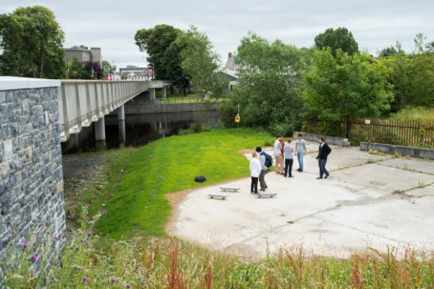
Co-design process
Participatory design Process
Co design workshop – 31st July
Urban Design Architects- Todo Por La Praxis
Familiarise participants with site and context
Plan Sketching & on site 1:1 marking
Issues Discussed
How the skate park integrates into wider urban
regeneration project
Integration of pedestrian path crossing through
the area.
Safe area for people to watch the skaters or
hang around.

Slide 13
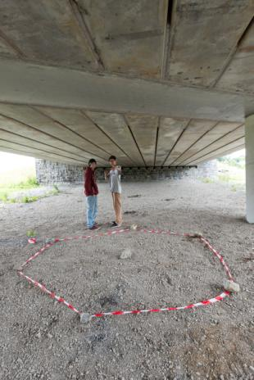
Skate Park Design
Skate Park Design Considerations
Bowl
Street Skate
Weather
Balancing the complexity of elements
Lighting
Access
Seating
Capacity
Security & Safety
Maintenance
Drainage
Storage

Slide 14
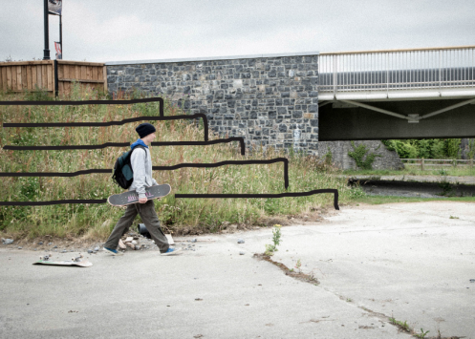
Sketch Design
Project design / Plan Sketches
General strategy
Placement & integration of elements
Precise design of the overall skating circuit
Integrated chill out or rest area
Grandstand area to connect lower and higher levels
Could also facilitate performance, theatre, music etc
Electricity supply – powered by photovoltaic
Wi-fi public connection
Storage space
Use of Brewery Artefacts

Slide 15
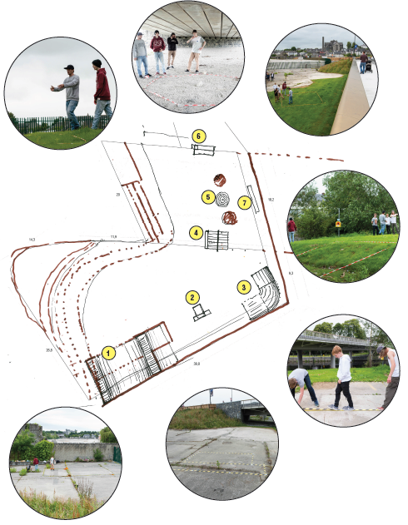
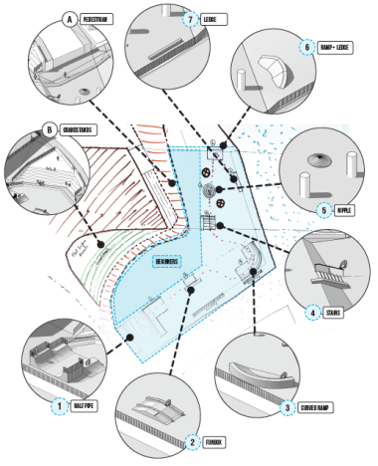
Outline Design

Slide 16
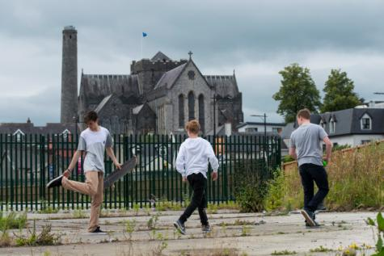
Next Steps
Detailed Design – KRSP grant from Sport Ireland
Ongoing engagement with youth community
in the detailed design of the space
Part VIII Planning
Application for Sports Capital Funding
(National Lottery Funding)

